Slide 2
Physical and chemical changes are used to recycle household waste
TRACK WITH ME
READ WITH ME
Students will be able to describe the steps and physical and chemical changes that occur during recycling the different compounds of plastics, glass and metals

Slide 3
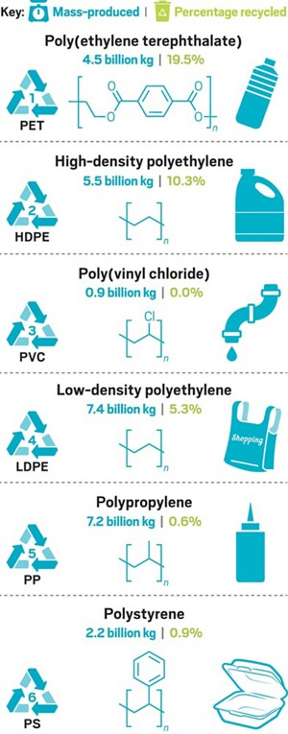
Physical and chemical changes are used to recycle household waste
Today, there is a large range of recyclable materials including paper, glass, plastics and aluminium.
By recycling these materials, society is able to conserve these resources and reduce the cost of producing new materials.
In most cases when a material is recycled, the form of the material may change but the material itself stays the same.
Therefore, the recycling process is simply a series of physical changes.

Slide 4
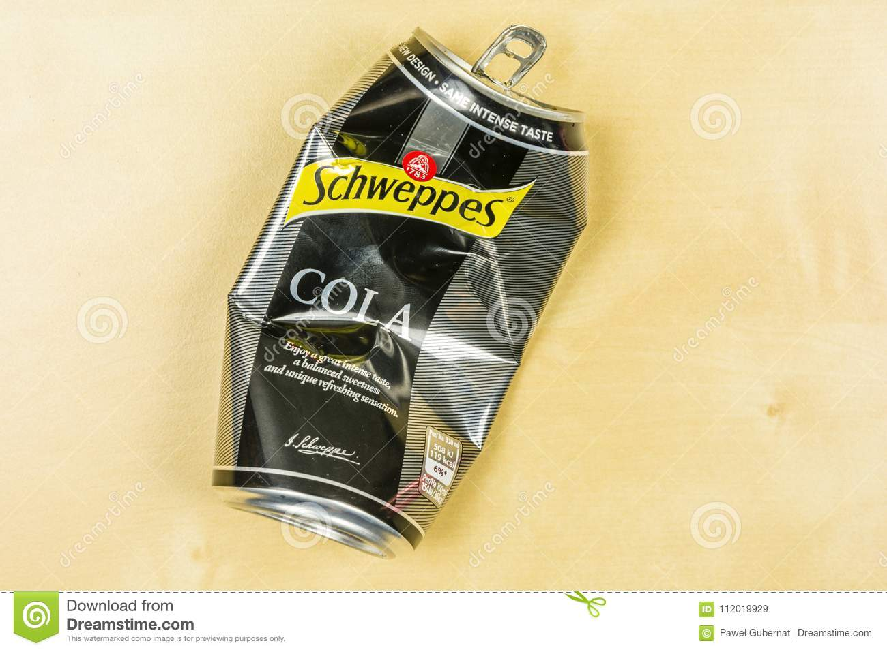
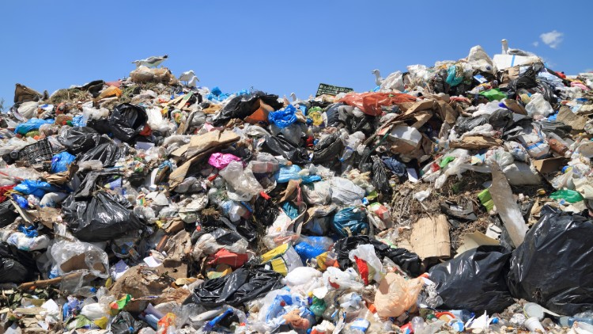
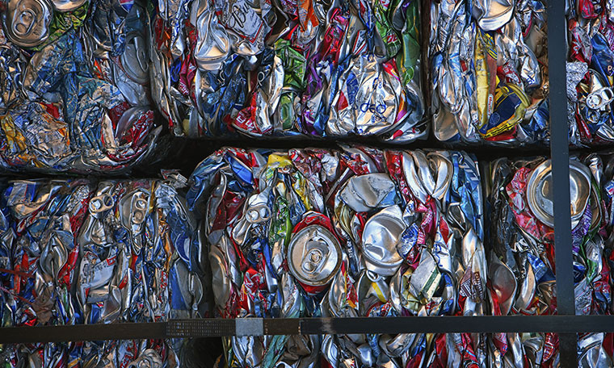
Physical and chemical changes are used to recycle household waste
Physical changes when recycling aluminium cans
Crushing: When you finish a can of soft drink you might crush the can before throwing it away.
Mixing: When you throw the can in the rubbish bin it is mixed with all the other materials, creating a mixture of garbage.
Separation: Before the aluminium cans can be recycled, they must be separated out of the garbage and cleaned

Slide 5
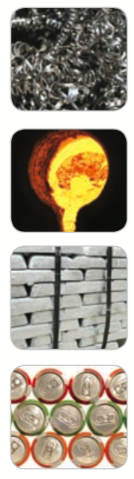
Physical and chemical changes are used to recycle household waste
Shredding: Once cleaned, the aluminium cans are shredded into tiny pieces.
Melting: The aluminium pieces are then melted into liquid aluminium, which is then poured into moulds
Solidification: The liquid aluminium is allowed to cool and solidify, forming blocks of pure aluminium, known as ingots.
Processing: The ingots can then be processed into any aluminium product, including more aluminium cans to start the process all over again.

Slide 6
Physical and chemical changes are used to recycle household waste
Understanding the difference between physical and chemical reactions can help us understand which objects can be recycled.
Objects that can undergo physical reactions can be easily recycled because the reactions are reversible and new shapes can be formed.
Chemical reactions can be used to create new materials that can be used again.

Slide 7
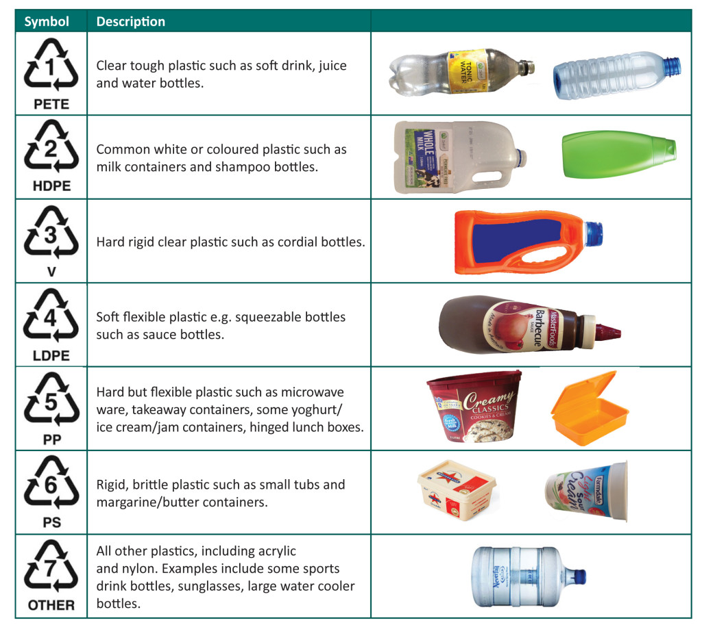
Physical and chemical changes are used to recycle household waste
Types of plastics
Plastics are made from a chemical reaction with crude oil.
This is hard to recycle and as most plastic products are only designed to be used for one year, they often end up in land-fill.
Recycling the chemicals in the plastic is often cheaper than the oil needed to create new products.
All recycled plastic belongs in seven groups.

Slide 8
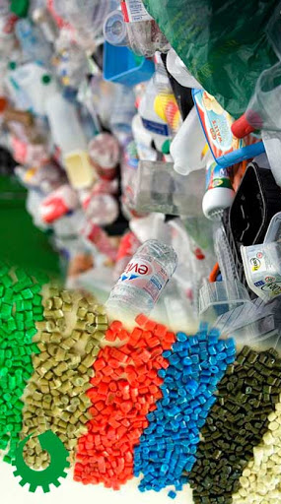
Physical and chemical changes are used to recycle household waste
Mechanical/physical recycling of plastics
This is broken into several steps.
Cutting the large pieces of plastic using shears or saws.
Shredding the plastic into small flakes.
Separating the contaminants in cyclone (centrifuge) separators.
Floating of the plastics according to their density.
Extruding the plastic by heating it to a melting state and forcing it into long strands.
Cooling the strands and cutting it into small pellets so that it can be reused for new products.

Slide 9
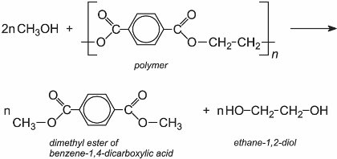
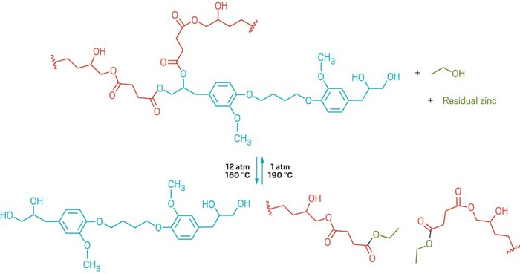
Physical and chemical changes are used to recycle household waste
Chemical recycling of plastics
Chemical recycling involves creating a chemical reaction that causes the long polymer molecules that make up the plastic to break into smaller molecules called monomers.
This requires a lot of energy because it is trying to reverse the initial chemical change that created the plastic.
As the initial reactants (crude oil) become more expensive, the chemical recycling of plastics will become a more attractive option.

Slide 10
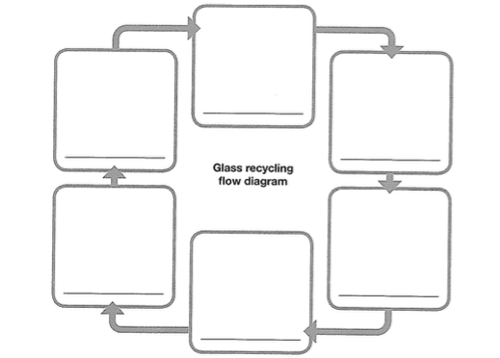
Physical and chemical changes are used to recycle household waste
Glass makes up 7% of domestic waste.
Fortunately glass can be recycled over and over again.
During the recycling process glass goes through several physical changes
Draw this flow chart in your books – make the squares large (fill up your whole page)

Slide 11
Physical and chemical changes are used to recycle household waste
Write the following steps into your flow chart.
When you throw the glass into the bin, it gets mixed in with the rest of the rubbish.
The glass is separated from the general waste
The glass is separated by colour
Each type of glass is crushed into small pieces
The small pieces of glass are melted in a furnace to make liquid glass, which is then poured into moulds
The glass is allowed to solidify into its new form, such as bottles, plates or windows.

Slide 12

Physical and chemical changes are used to recycle household waste

Slide 13
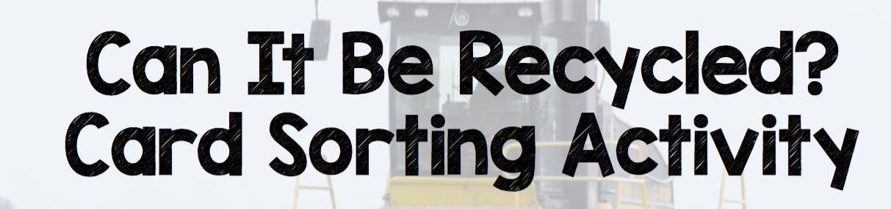
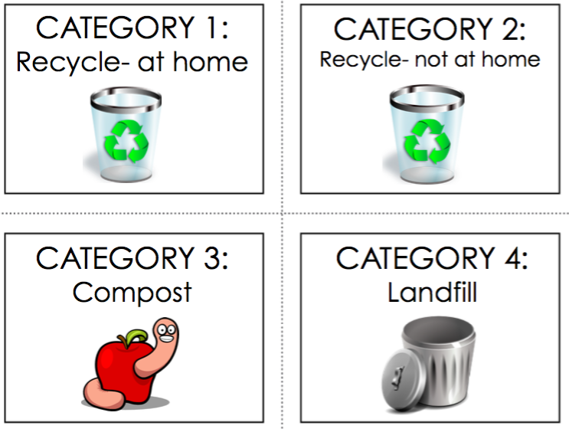

Slide 14

Questions
What criteria did you use to help you sort your cards?
Which cards did you find hard to place?
Using one sentence how do chemical changes and physical changes differ?

Slide 15
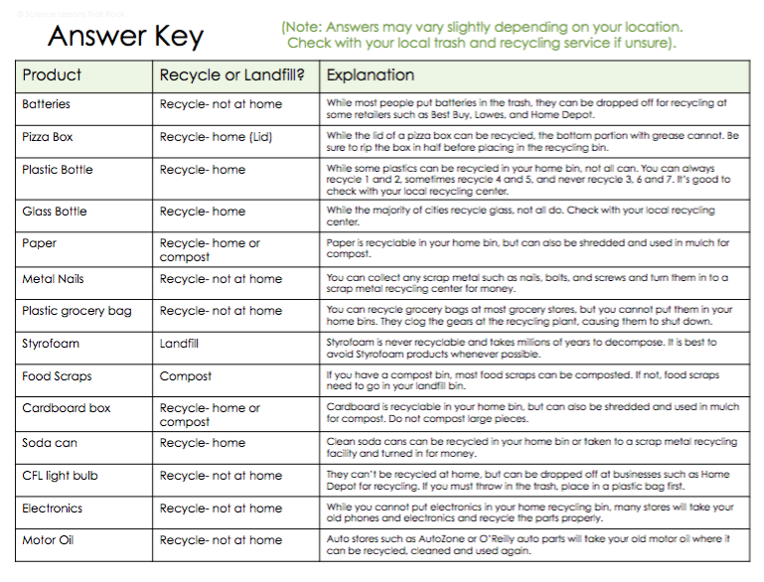
Answers
Answers

Slide 16
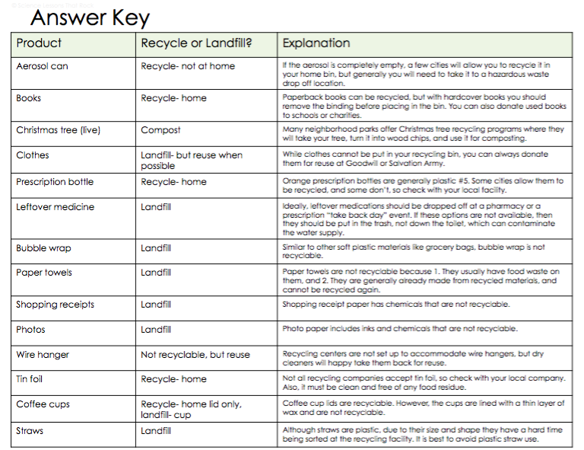
Answers
Answers

Slide 17
Physical and chemical changes are used to recycle household waste
TRACK WITH ME
READ WITH ME
Students will be able to describe the steps and physical and chemical changes that occur during recycling the different compounds of plastics, glass and metals

